Slide 1
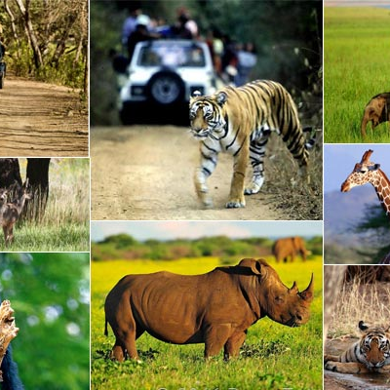
WILDLIFE SANCTUARY WEBSITE
ADIL AHMAD DAR – 20CS1004
BEENA SAMUEL – 20CS1020
M. HEMAPRIYA – 20CS1048

Slide 2
Problem statement:
The population of animals is decreasing day by day. This is due to the lack of a living space and unavailability of food due to human intervention into their habitats.
Many animals are hunted for their tusks, skin etc., We need to protect animals which are on the verge of extinction.
Therefore , we develop this online platform to create awareness about the sanctuary, its conservation efforts, the various species of animals found there, and the measures being taken to protect them.

Slide 3
Problem statement:
To create a sustainable and responsible tourism model that balances the conservation of wildlife and their habitats with the economic benefits derived from tourism.
To provide an enjoyable and educational experience for tourists while also ensuring the safety and welfare of the animals, promoting environmental awareness and conservation, and contributing to the local community's economic development.
To enable an interactive mode for the convenience of tourists to book tickets and rides, reserve rooms, provide feedbacks and much more.

Slide 4
Objectives:
To attract tourists by providing information about the unique experiences, attractions, rides and activities available.
Enhancing online presence: To enhance the sanctuary's online presence, making it more visible and accessible to potential visitors and creating a positive image for the sanctuary.
Improving visitor experience: To improve the visitor experience by providing comprehensive information about the sanctuary, including visitor guidelines, sightseeing options, and accommodation.

Slide 5
Objectives:
Educating visitors: To educate visitors about the importance of conservation efforts, the impact of human activities on wildlife and the environment, and how they can help protect the natural world.
Measuring success: To measure its success by tracking metrics such as tourists numbers, revenue generated, tourists satisfaction ratings and feedbacks, and conservation impact, and using this data to make informed decisions about future initiatives and investments.
Utilizing social media: The website can leverage social media platforms to reach a wider audience, engage with visitors, and promote the sanctuary's offerings and initiatives.
Boosting revenues: The website could be designed to generate revenue by tourism and encouraging visitors to donate to support conservation efforts.

Slide 6
TECHNOLOGY STACK
TYPE | TECHNOLOGY
Frontend | React JS
Backend | Spring Boot
Database | MySQL
ORM Mapping | JPA Hibernate
Testing | Junit Mockito
Code Coverage | EclEmma

Slide 7
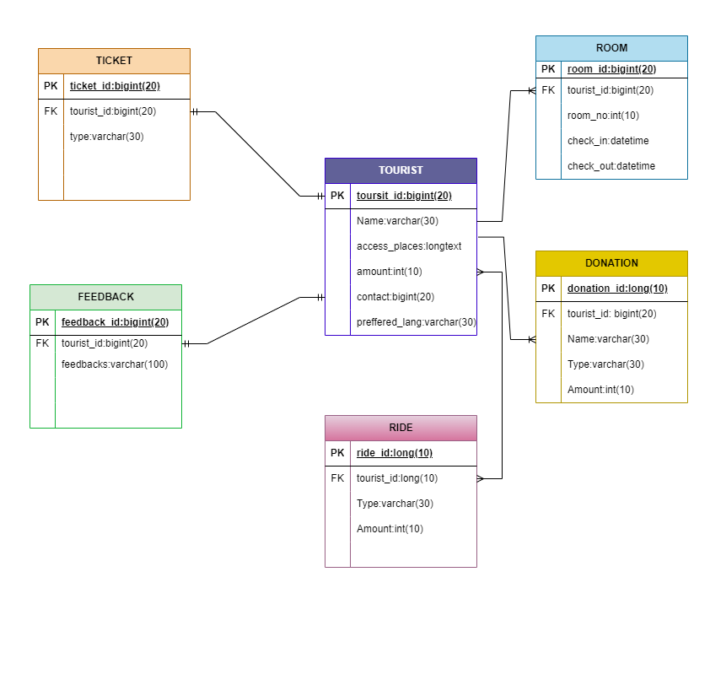
Entity Relation diagram:

Slide 8
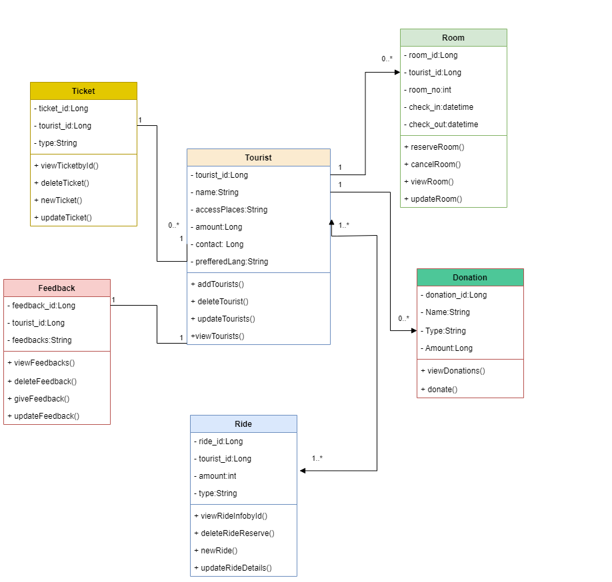
Class diagram:

Slide 9
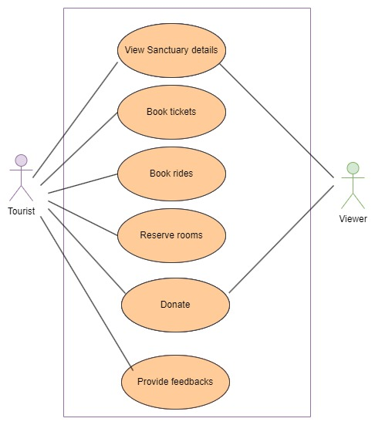
Use case diagram:

Slide 10
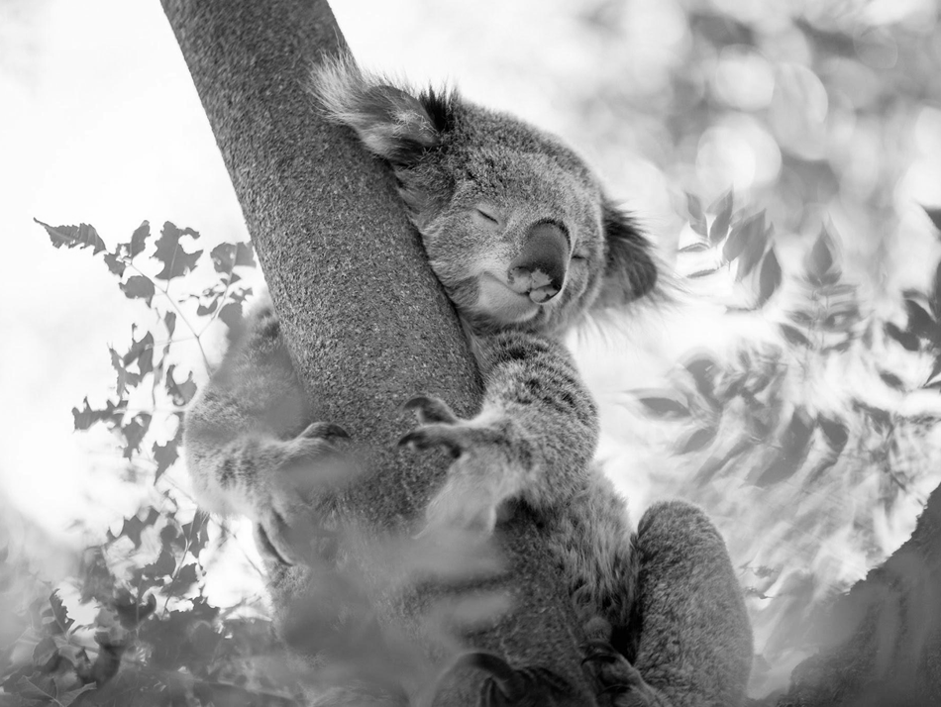
THANK YOU

